Slide 1
Tableau Project
Project By -: Pratik Darandale
THIS PROJECT IS BASED ON US SUPERMARKET, AS PER THE DATA SET, GOT SOME INSIGHTS FOR BETTER UNDERSTANDING
THIS DATASETS CONSIST OF 15 COLUMNS & 1001 ROWS
FROM THIS DATASET, THE FIELDS WHICH ARE USED AS FOLLOWS :-
INVOICE, BRANCH, COUNTRY, STATES, CUST_TYPE, GENDER, PRODUCT TYPE UNIT_PRICE, QUANTITY, DATE, TIME, PAYMENT, SALES, GROSS INCOME & RATING

Slide 2
PROBLEM STATEMENTS
OVERVIEW :–
OVERALL SALES :– 307587, GROSS INCOME :– 15379.36, TOTAL CUSTOMERS :– 1000
MONTH VS GROSS INCOME
PRODUCT TYPE VS STATE WISE SUM OF QUANTITY
PRODUCT TYPE VS PAYMENTS MODE
STATE VS TYPE SUM OF SALES & RATING
SATET VS TOTAL SUM OF SALES
PRODUCT TYPE VS UNIT PRICE & QUNTITY
PRODUCTS TYPE VS MALE/FEMALE ORDER

Slide 3
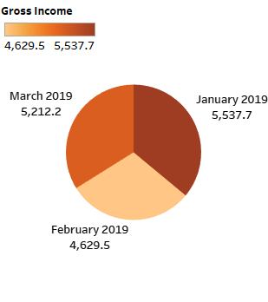
MONTH VS GROSS INCOME

Slide 4
MONTH VS GROSS INCOME - Story
HIGHEST GROSS INCOME - JANUARY 2019 - 5537.7
LOWEST GROSS INCOME - FEBRUARY 2019 – 4629.5
LEGEND - GROSS INCOME
INSIGHTS –
IN JANUARY 2019 & MARCH 2019 THE GROSS INCOME WAS AVERAGE
AND FABRUARY 2019 SALE WAS LOW DUE TO LESS ORDER OF QUNTITY

Slide 5
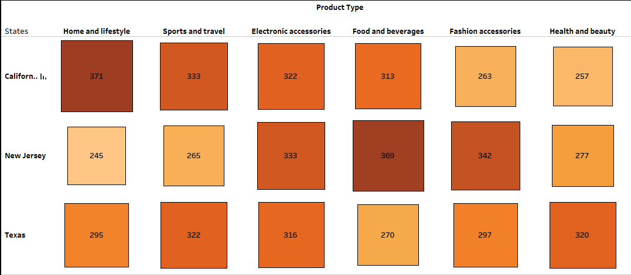
Product type vs State wise Sum Of Quantity
HIGHEST SUM OF PRODUCT QUNTITY IS 371 AND THE PRODUCT WAS HOME AND LIFESTYLE IN CALIFORNIA
LOWEST SUM OF PRODUCT QUNTITY IS 245, PRODUCT WAS HOME AND LIFESTYLE IN NEW JERSEY
AND THE HIGHEST SUM OF PRODUCT QUNTITY IS 971 AND PRODUCT WAS ELECTRONIC ACCESSORIES IN ALL THREE STATE.

Slide 6
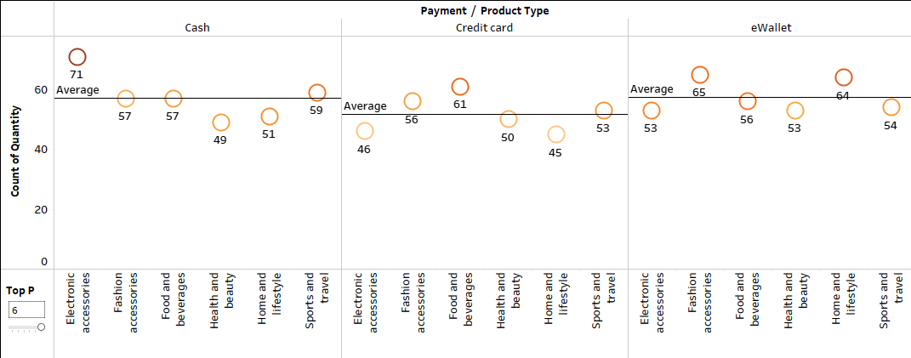
PRODUCT TYPE VS PAYMENTS MODE

Slide 7
PRODUCT TYPE VS PAYMENTS MODE- STORY
MAXIMUM PAYMENT MODE USED IS CASH AND COUNT IS 71 FOR ELECTRONICS ACCESSORIES
MINIMUM PAYMENT MODE USED IS CREDIT CARD AND COUNT IS 45 FOR HOME AND LIFESTYLE
THE AVERAGE USE OF CASH AND EWAALET PAYMENT MODE HAS DONE IN ALL THE PRODUCT TYPES
PARAMETER USED - TYPE OF PRODUCT.
REFERENCE LINE - AVERAGE

Slide 8
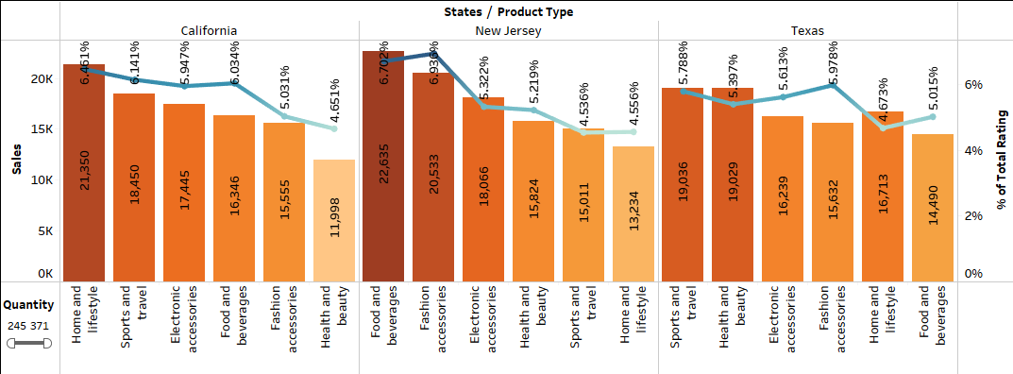
STATE VS TYPE SUM OF SALES & RATING

Slide 9
STATE VS TYPE SUM OF SALES & RATING - STORY
THE HIGHEST SALE WAS HOME AND LIFESTYLE WITH HIGHEST SUM OF RATING AND THE LOWEST SALE WAS HEALTH AND BEAUTY WITH LOWEST SUM OF RATING IN CALIFORNIA.
THE HIGHEST SALE WAS FOOD AND BEVERAGES WITH HIGHEST SUM OF RATING AND THE LOWEST SALE WAS HOME AND LIFESTYLE WITH LOWEST SUM OF RATING IN NEW JERSEY.
THE HIGHEST RATING HAS GIVEN TO THE FASHION ACCESSORIES AMOUNG THE THREE STATE

Slide 10
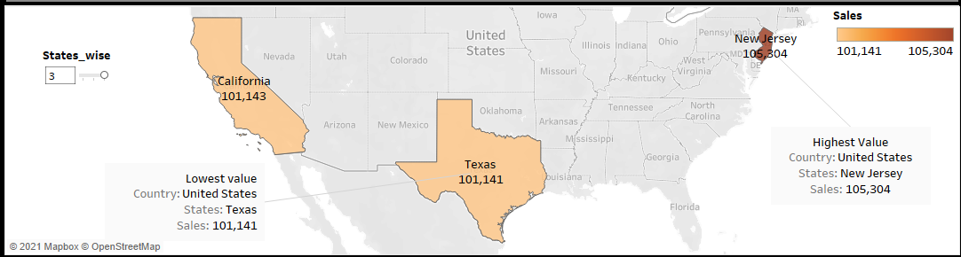
SATET VS TOTAL SUM OF SALES
THE HIGHEST SALES IS IN THE NEW JERSEY WHICH IS 105,304
IN CALIFORNIA AND TEXAS THE SALE WAS ALMOST SAME WHICH IS 101.143 AND 101,141 RESP.
USED ONE FILTER AND ONE LEGEND ALSO USED TWO ANNOTATE

Slide 11
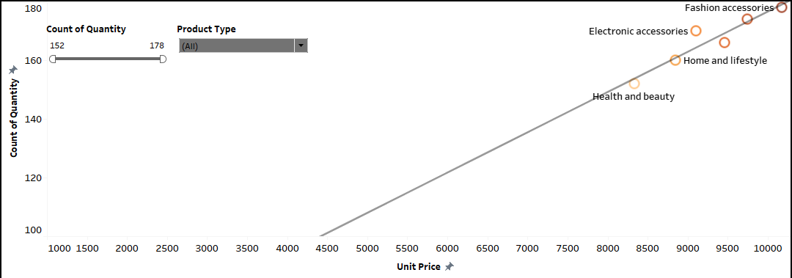
PRODUCT TYPE VS UNIT PRICE & QUANTITY
THE HIGHEST UNIT PRICE :- 10173 AND QUANTITY :- 178 OF PRODUCT TYPE “FASHION ACCESSORIES”
AND LOWEST UNIT PRICE :- 8338 AND QUANTITY :- 152 OF PRODUCT TYPE “HEALTH AND BEAUTY”
USED TWO FILTERS WHICH PRODUCT TYPE AND COUNT OF QUANTITY AND ALSO USED TREND LINE

Slide 12
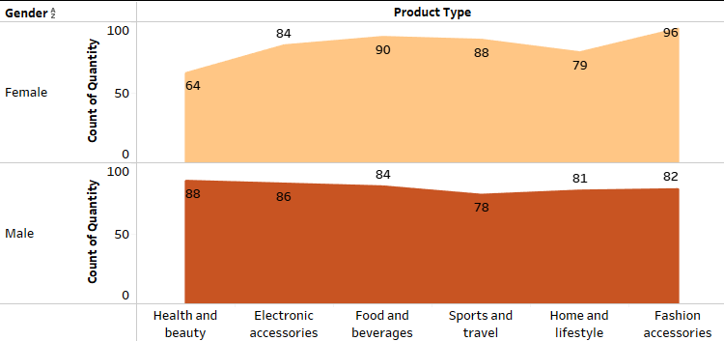
PRODUCTS TYPE VS MALE/FEMALE ORDER
“FASHION ACCESSORIES” WAS THE MAXIMUM PRODUCT TYPE WHICH WAS TAKEN BY FEMALE IS 96 AND LOWST “HEALTH AND BEAUTY” IS 64.
“HEALTH AND BEAUTY” WAS THE MAXIMUM PRODUCT TYPE WHICH WAS TAKEN BY MALE IS 88 AND LOWST “SPORTS AND TRAVEL” IS 78

Slide 13
SOURCE DATA
DATASET
https://www.kaggle.com/mahmoudeletrby/supermarket
TABLEAU PUBLIC SOURCE
https://public.tableau.com/shared/YGST3MHRM?:display_count=n&:origin=viz_share_link
VIDEO PRESENTATION LINK
https://drive.google.com/file/d/1e36LEqBYWtqOHySCNv8YDd9z9TGAO0qT/view?usp=sharing

Slide 14
CONCLUSION
MONTH VS GROSS INCOME
HIGHEST GROSS INCOME - JANUARY 2019 - 5537.7
LOWEST GROSS INCOME - FEBRUARY 2019 – 4629.5
PRODUCT TYPE VS STATE WISE SUM OF QUANTITY
HIGHEST PRODUCT ORDER WAS HOME AND LIFESTYLE WHICH IS 371 IN CALIFORNIA.
LOWEST PRODUCT ORDER WAS HOME AND LIFESTYLE WHICH IS 245 IN NEW JERSEY.
PRODUCT TYPE VS PAYMENTS MODE
HIGHEST PAYMENT MODE USED - CASH
LOWEST PAYMENT MODE USED – CREDIT CARD
STATE VS TYPE SUM OF SALES & RATING
HIGHEST SALE & RATING IN NEW JERSEY OF PRODUCT “FOOD AND BEVERAGE”.
LOWEST SALE & RATING IN CALIFORINA OF PRODUCT “HEALTH AND BEAUTY”.

Slide 15
SATET VS TOTAL SUM OF SALES
HIGHEST SALE IN NEW JERSEY – 105,304
LOWEST SALE IN TEXAS – 101,141
PRODUCT TYPE VS UNIT PRICE & QUNTITY
THE HIGHEST UNIT PRICE :- 10173 AND QUANTITY :- 178 OF PRODUCT TYPE “FASHION ACCESSORIES”
AND LOWEST UNIT PRICE :- 8338 AND QUANTITY :- 152 OF PRODUCT TYPE “HEALTH AND BEAUTY”
PRODUCTS TYPE VS MALE/FEMALE ORDER
HIGHEST ORDER FOR MALE OF PRODUCT “HEALTH AND BEAUTY” – 88
LOWEST ORDER FOR MALE OF PRODUCT “SPORTS AND TRAVEL” – 78
HIGHEST ORDER FOR FEMALE OF PRODUCT “FASHION ACCESSORIES” – 96
LOWEST ORDER FOR FEMALE OF PRODUCT “HEALTH AND BEAUTY” – 64

Slide 16
DASHBOARD

Slide 17
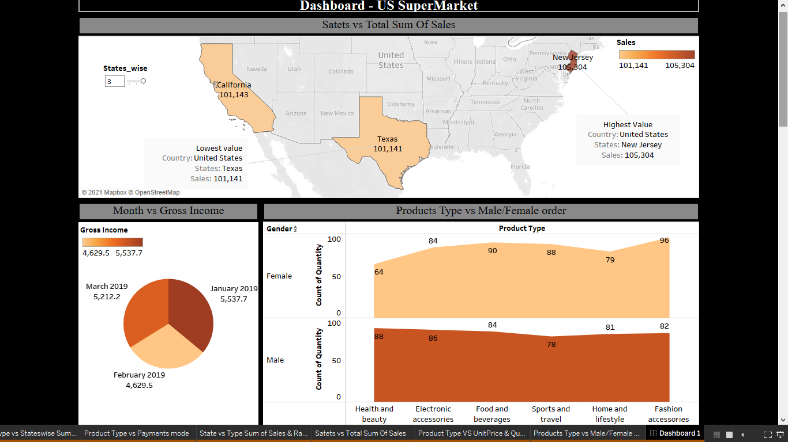

Slide 18
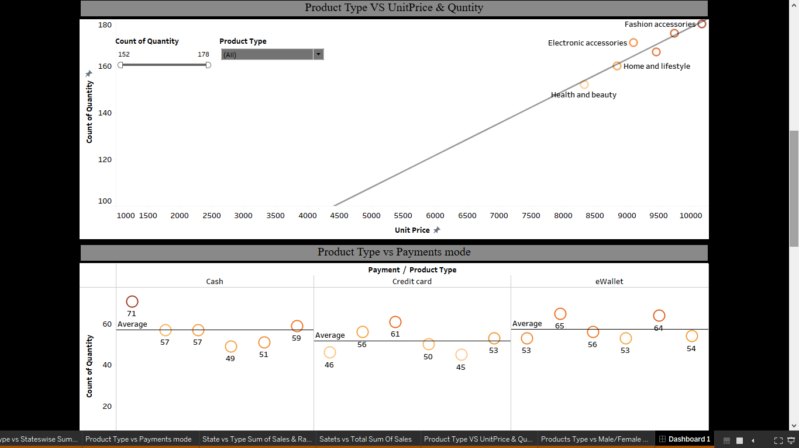

Slide 19
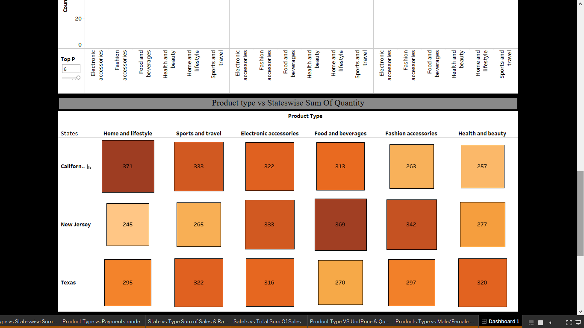

Slide 20
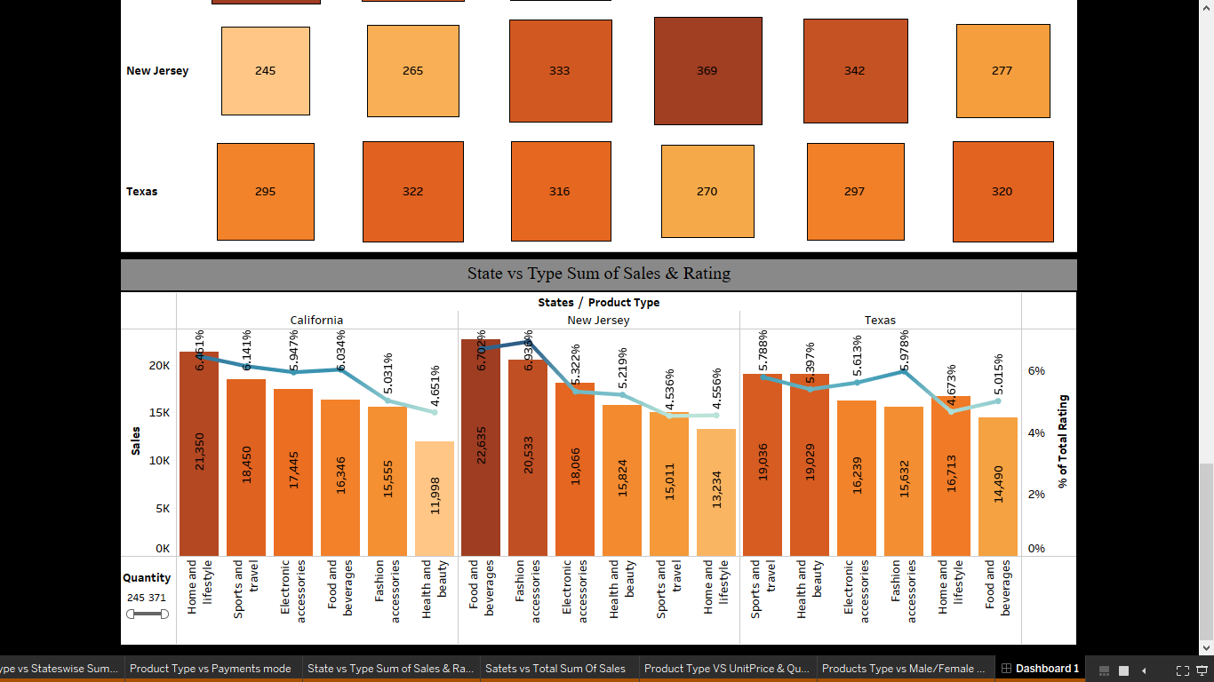

Slide 21
THANK YOU

